Slide 1
Synthetic Aperture Radar (SAR) Applications
William Pichel
NOAA/NESDIS
Center for Satellite Applications and Research (STAR)
Outline:
1. Introduction to SAR
2. Advantageous characteristics of SAR for remote sensing of
environmental information
3. NOAA applications of SAR (ocean emphasis)
4. Oil spill mapping during the Deepwater Horizon Event
5. Operational implementation of SAR – status and plans
NOAA Technology Summit – November 3, 2010, Silver Spring

Slide 2
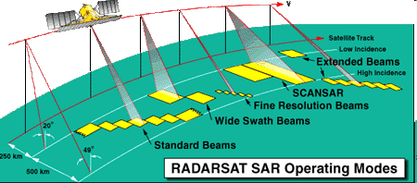
Introduction to SAR
Synthetic Aperture Radar (SAR) instruments are active microwave instruments operating at cm wavelengths (X-band: 3 cm, C-band: 5 cm, L-band: 23 cm).
High resolution (1 m – 150 m) is achieved by and signal processing of the backscattered radar signal (both amplitude and phase).
Single beam swath widths are 30-150 km. Time multiplexed multi-beam (called ScanSAR) swath widths are typically 100-500 km.

Slide 3
SAR High Resolution Achieved via
Signal Processing
SAR is a marriage of radar and signal processing technologies.
Cross Track (Range)
Resolution
High range resolution
is achieved with a small
effective radar pulse width obtained by frequency modulation of the transmitted radar pulse.
Desired large antenna
Sensor flight path
=> target must backscatter energy to the sensor for the entire synthetic aperture length
β
Target
=> β = azimuth beamwidth
Along-Track (Azimuth) Resolution
High azimuth resolution is achieved by aperture synthesis. The coherent doppler phase history of a target is preserved during the entire time the target is illuminated and then processed to focus the location of the target at its correct image pixel. The resulting resolution is as if an antenna of about 15 km were available.

Slide 4
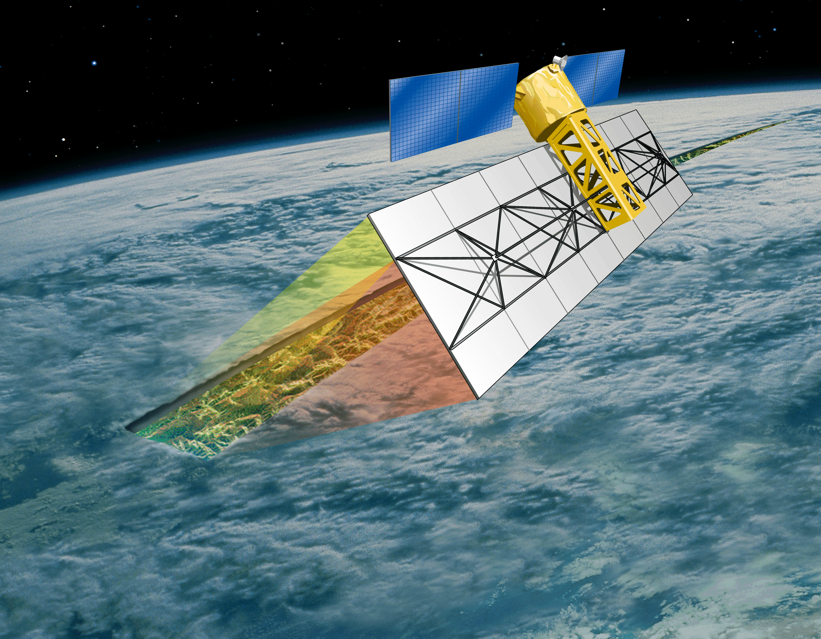
What is New About SAR Technology?
SAR is not so much a new technology
as it is a maturing one:
First spaceborne SAR was on Seasat,
launched in 1978
This technology is maturing to the point of
becoming operational
Recent developments include:
  Data available from many satellites (more than 10 currently operating)
  Multiple Frequencies – X, C, L
  Multiple polarizations – Dual and quad polarization
  Interferometry - Along-track and cross-track in addition to repeat pass
  Operational satellite constellations under development in Europe and
  Canada
  Maybe, finally, another U.S. SAR – DESDynI (and SMAP)

Slide 5
SAR Advantageous Characteristics for Environmental Applications
High resolution (< 100 m)
Cloudy/clear, day/night surface observations
(except through heavy rain)
Adjacent land does not contaminate ocean
    observations (right up to the coast
  and in bays/straits)
Phase preserving processing allows
  interferometric applications able to
      sense mm changes in topography

Slide 6
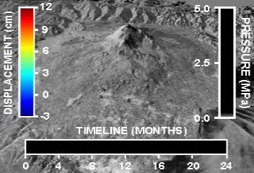
SAR is Instrument of Choice for
Some Important Applications
SAR is Best Instrument for Satellite Remote Sensing of:
  Sea and lake ice concentration/age/edge location/
  motion/leads
  Iceberg detection
  Coastal high-resolution (500 m) wind speeds
  Two-dimensional swell wave field measurements
  (Significant wave height,
  direction, wavelength)
  Oil spill location
  Internal wave mapping
  Ship and oil platform
  locations
  Earth surface deformation
Volcanic Displacement – Mount Etna
Prior to 1995 Eruption (NASA)

Slide 7
Ocean Remote Sensing with SAR
SAR Instruments are sensitive to any ocean phenomena which affects the roughness of the ocean surface on a scale of a few centimeters, such as:
Surface wind
Surfactants
Surface and internal waves
Frontal features
Upwelling
Shallow water bathymetric
features
Wave/current interaction
Hard targets
High Wind
Discharged material
Vessels
Low
Wind
RADARSAT-1 SAR Image
of Bering Sea Fishing Fleet

Slide 8
NOAA SAR Applications
Emphasis on ocean and atmospheric boundary layer measurements
Sea/lake/river ice
Coastal winds and boundary layer phenomena
Hurricanes
Ship detection / oil platform change detection
Bathymetry
Ocean features
Oil spills – Deepwater Horizon Event

Slide 9
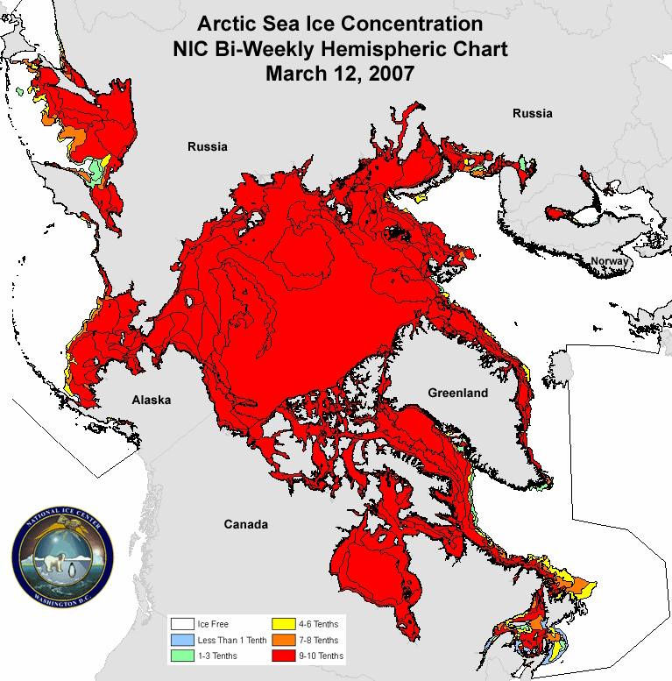
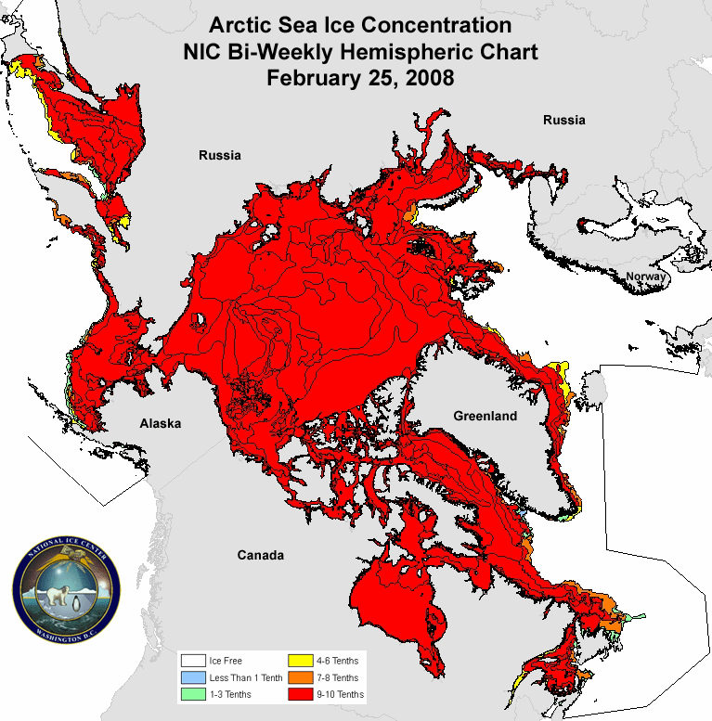
Arctic Sea Ice Retreat in 2007 and 2008 (NIC)
National Ice Center Uses SAR and other Imagery
to Map Global Sea Ice Extent
Parameter: Sea ice concentration/type/leads/ridges
Decision Support: Ship routing, search & rescue, polar research, climate change
Notes:
9

Slide 10
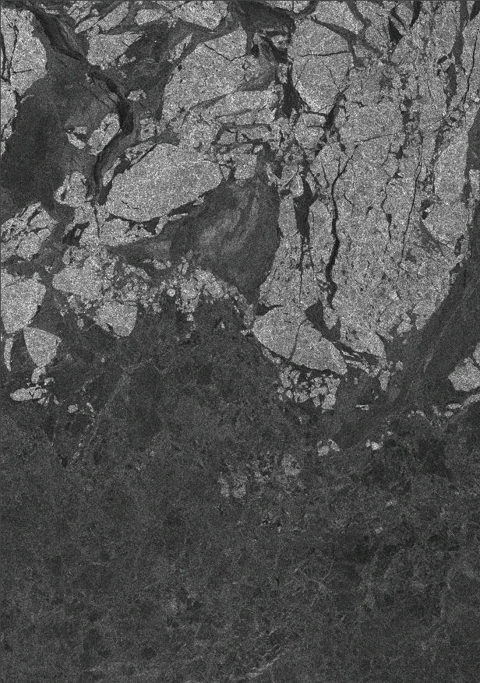
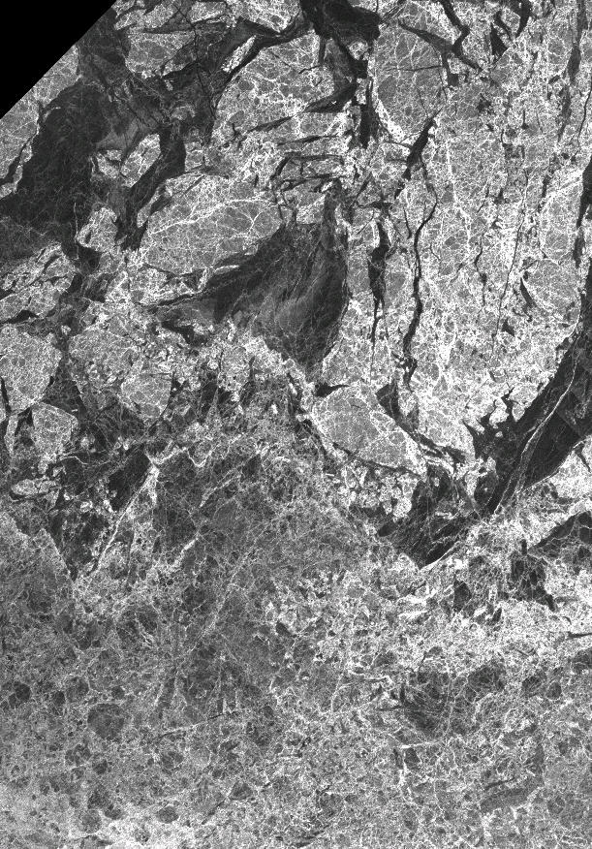

Multi-frequency Sea Ice Mapping by the National Ice Center
R1: Jan 13th 2008 @ 15:31Z
PALSAR: Jan 13th 2008 @ 20:10Z
MYI
MYI
FYI
FYI
C-band SAR: Good contrast between first-year ice and multiyear ice
L-band SAR: Excellent delineation of pressure ridges and floe shape

Slide 11
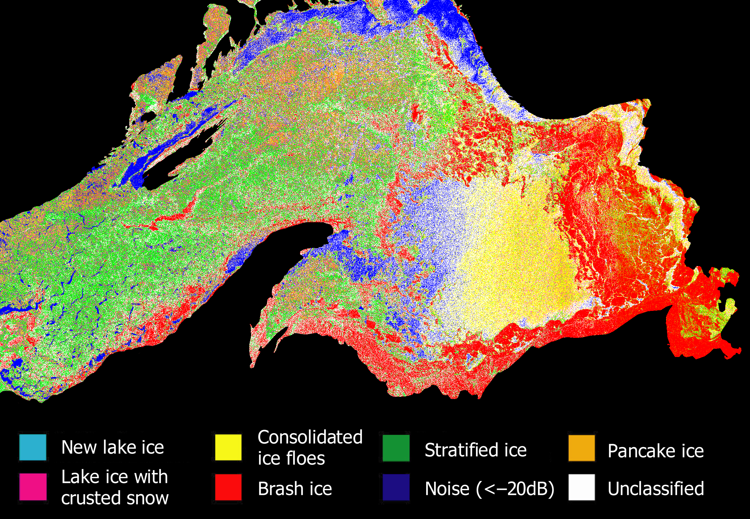
Great Lakes Ice Classification
Parameter: Lake ice type and location
Decision Support: Safety of lake transportation
Lake Superior
Research Ice Classification
RADARSAT-1
© CSA, 1997
March 22,1997
During GLAWEX’97
(GLERL)

Slide 12
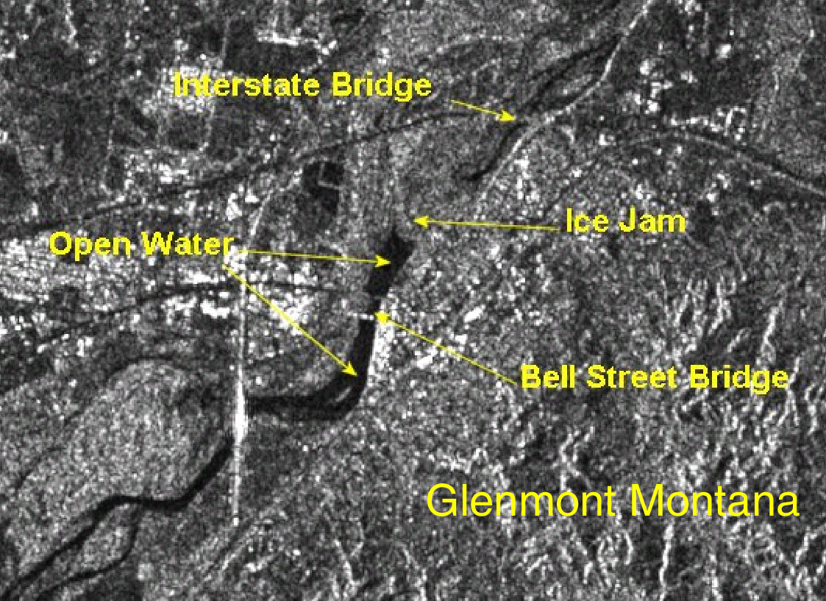
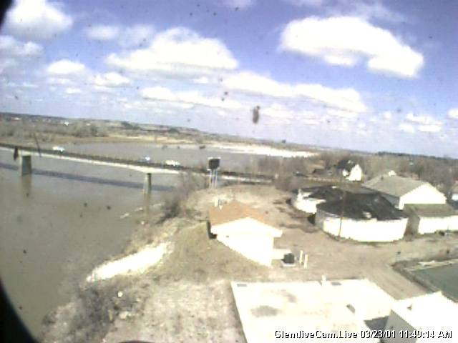
Monitoring Spring Ice Break-up on the
Yellowstone River, Montana
Parameter: River ice location/jams/runs/flooding
Decision Support: Safety of river transportation, flood warnings
RADARSAT-1 SAR © CSA, 2001
Ice Jam North of Bell Street Bridge, Glenmont, Montana - Photo March 23, 2001

Slide 13
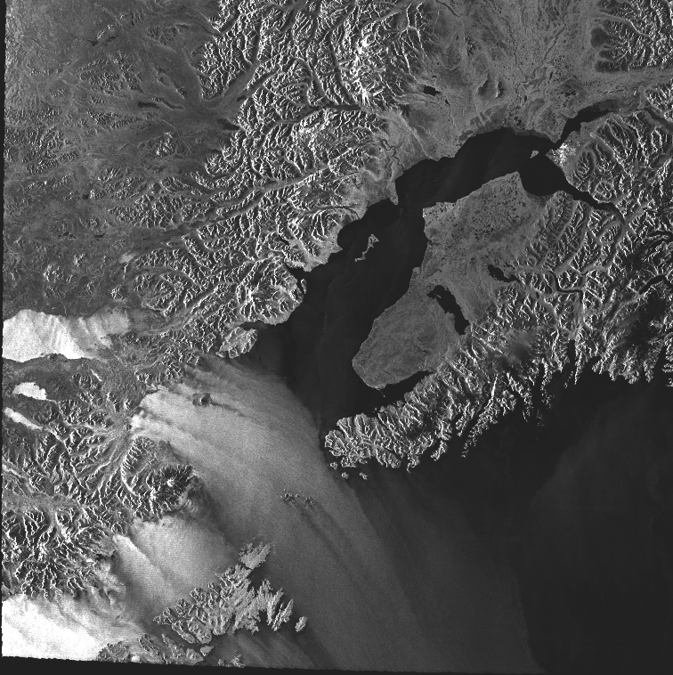
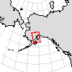
Wind Patterns in SAR Images
2000 Oct 31 03:44:24 UTC
RADARSAT-1 SAR
© CSA, 2000

Slide 14
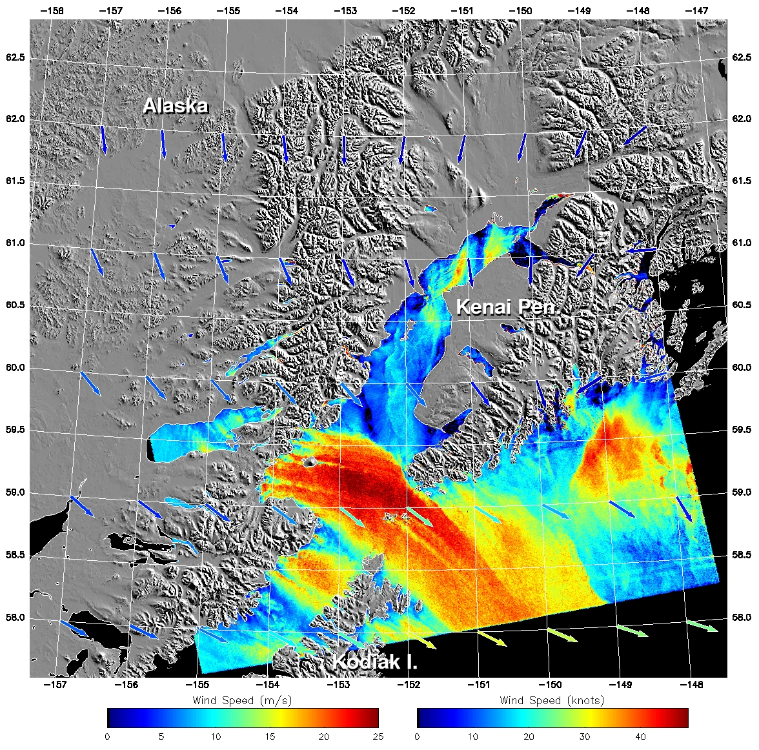
SAR Wind Image
Parameter: High-resolution surface wind speed
Decision Support: Safety of marine transportation, fishing, and small aircraft,
wind farm decisions, storm/hurricane warnings and forecasts
SAR calibrated backscatter (Normalized Radar Cross Section - NRCS) can be converted to wind speed using an a priori wind direction and a scatterometer Geophysical Model Function (GMF)
2000 Oct 31 03:44:24 UTC
RADARSAT-1
SAR Wind Image
CMOD4 Algorithm
(JHU/APL)

Slide 15
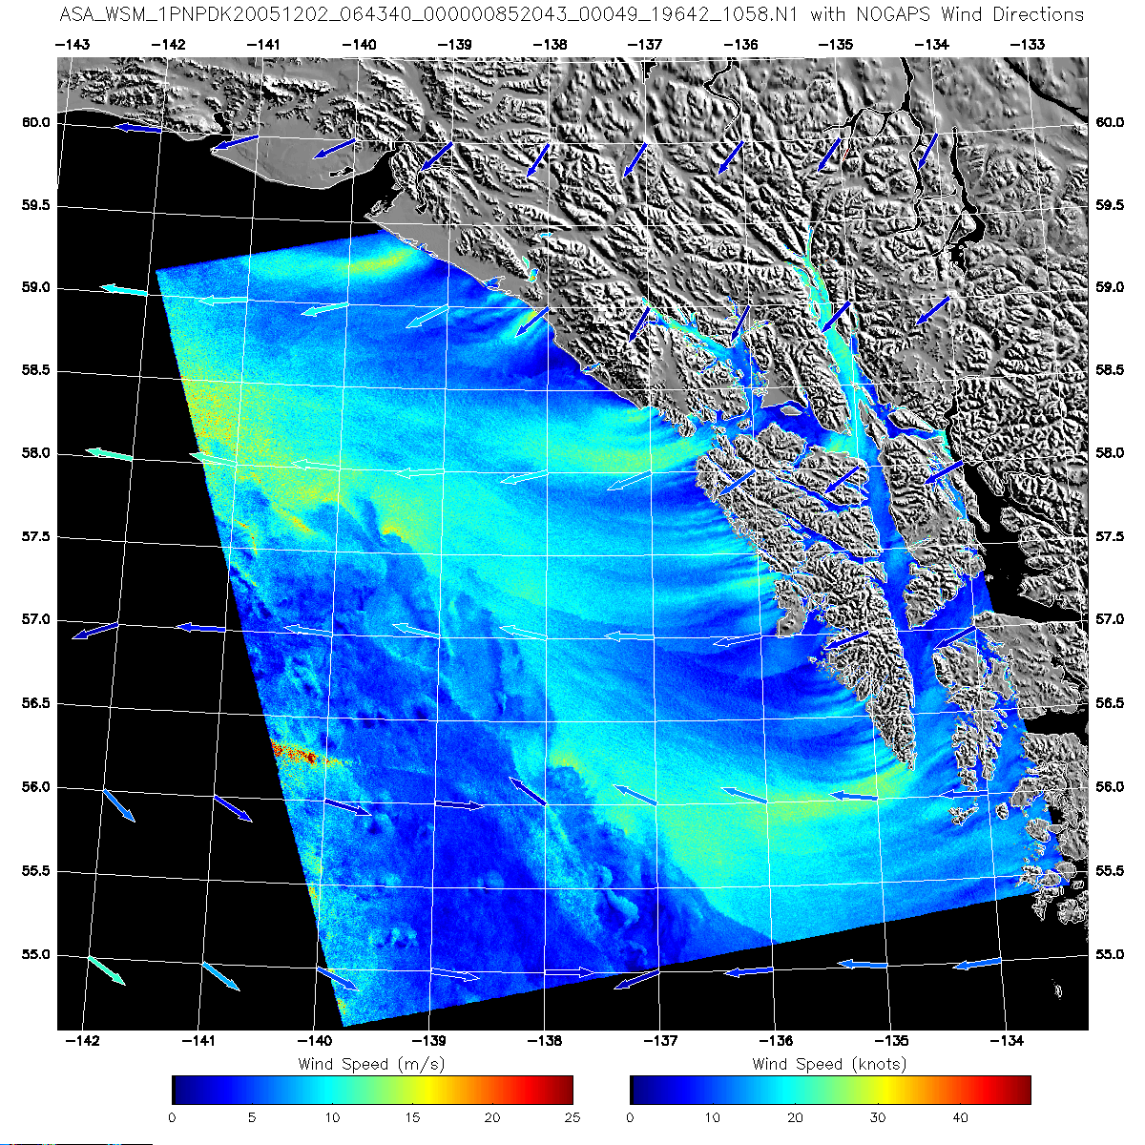
Wind Image – Southeast Alaska
ENVISAT
Wide Swath Mode
02 Dec. 2005
06:43 UT

Slide 16
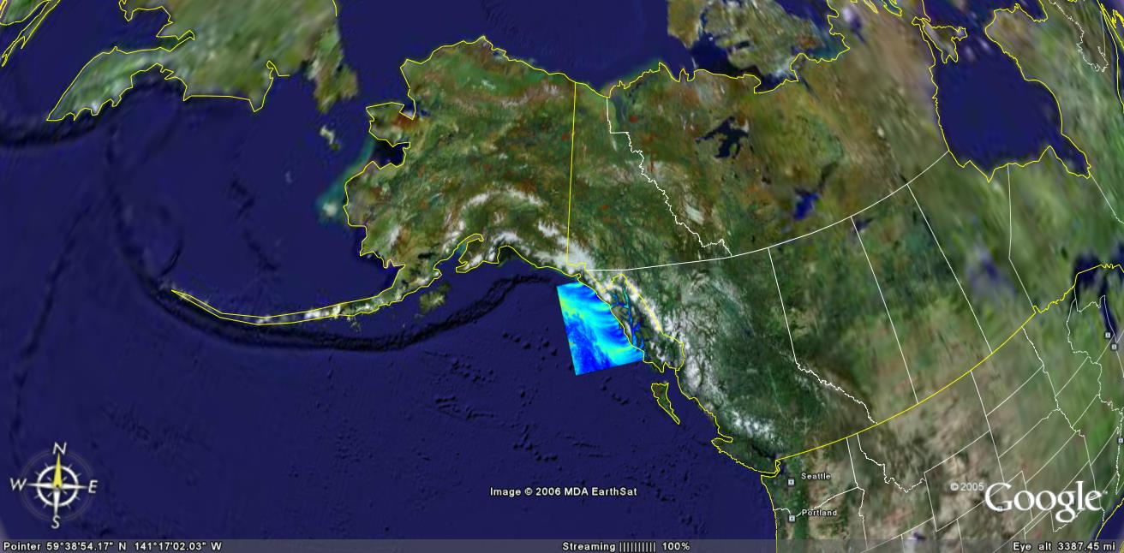

ENVISAT SAR Wind Image
Google Earth Display
Google Earth Display

Slide 17
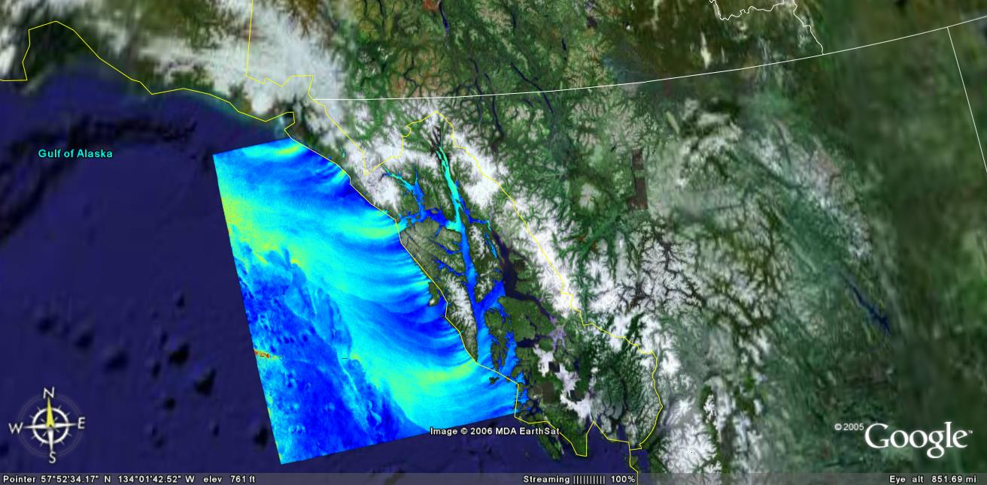
ENVISAT SAR Wind Image
Google Earth Display
Google Earth Display

Slide 18
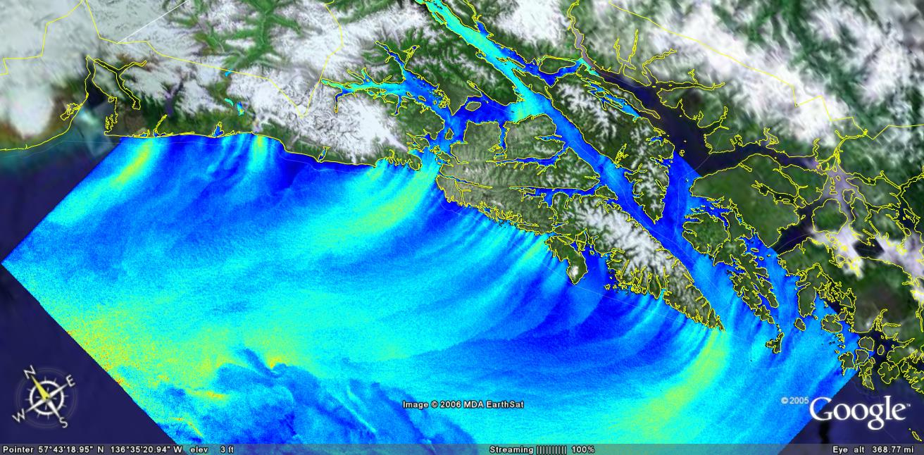
ENVISAT SAR Wind Image
Google Earth Display
Google Earth Display

Slide 19
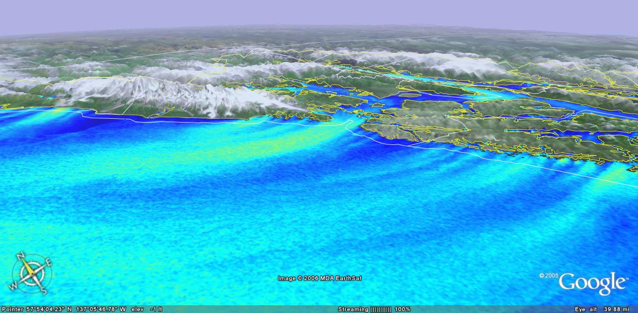
ENVISAT SAR Wind Image
Google Earth Display
Google Earth Display

Slide 20
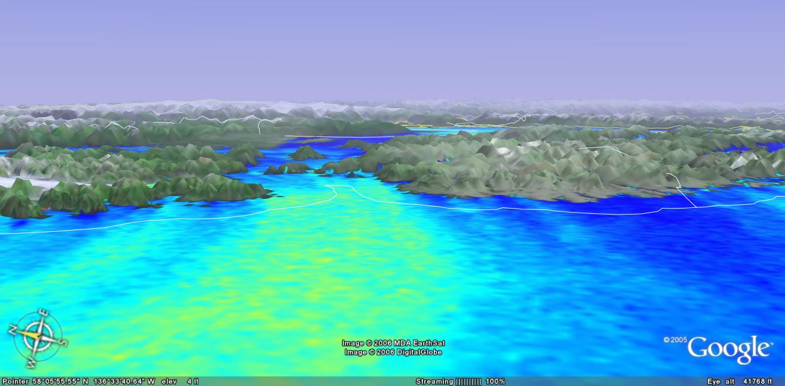
ENVISAT SAR Wind Image
Google Earth Display
Google Earth Display

Slide 21
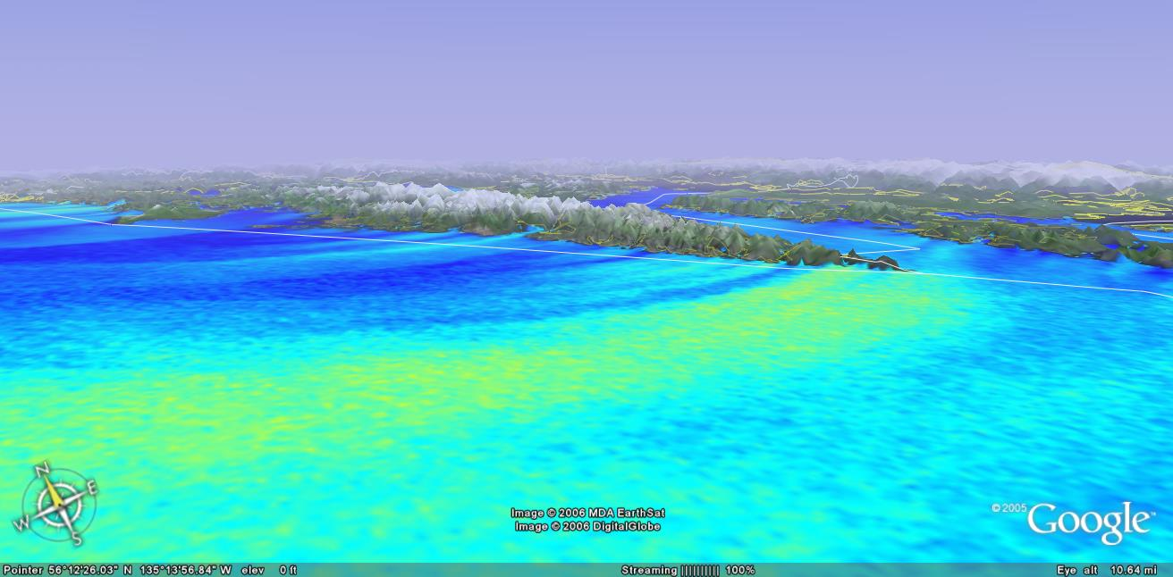
ENVISAT SAR Wind Image
Google Earth Display
Google Earth Display

Slide 22
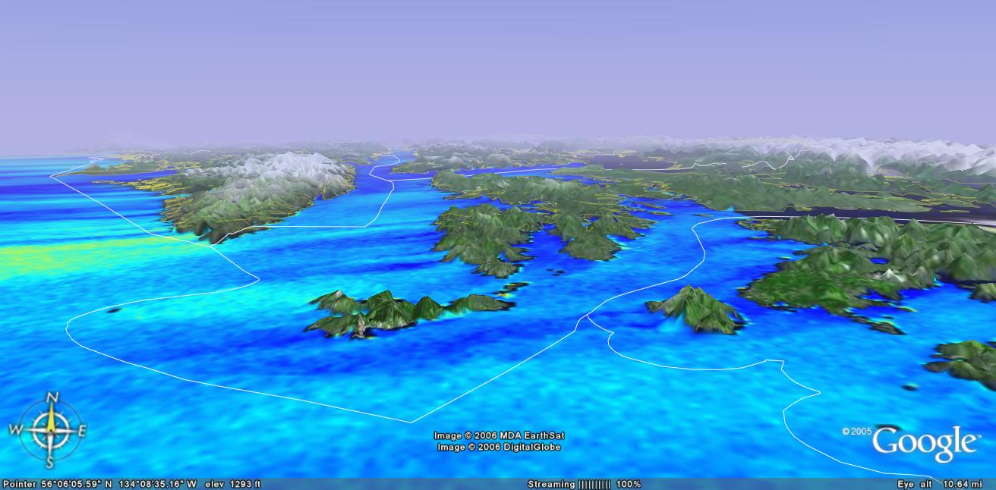
ENVISAT SAR Wind Image
Google Earth Display
Google Earth Display

Slide 23
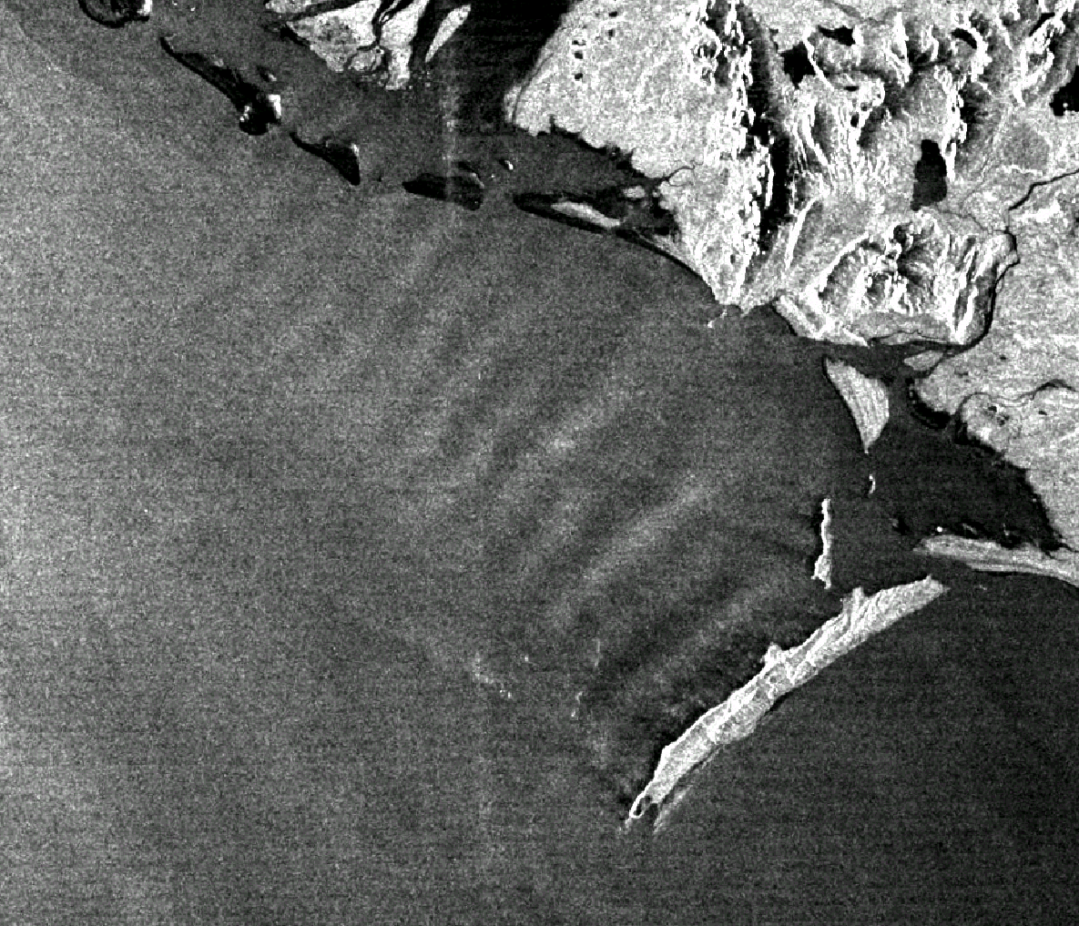
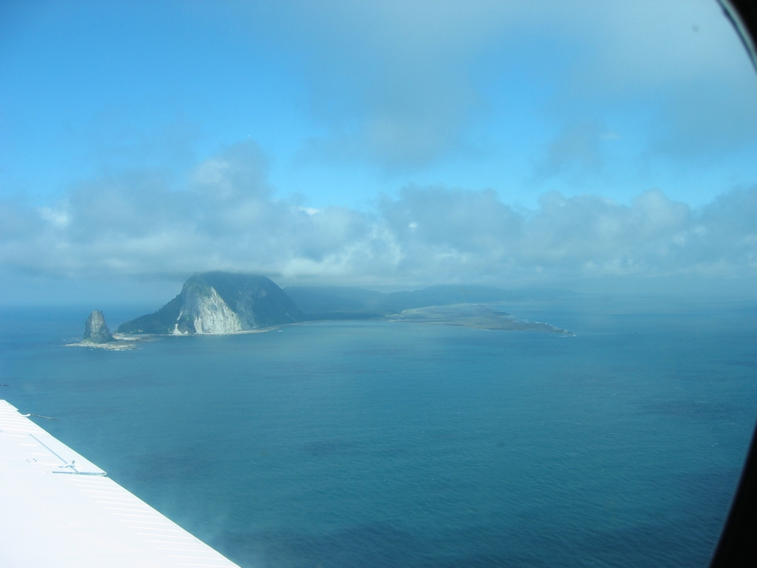
SAR-Observed Atmospheric Features
Island Lee Waves
Kayak Island
(Gulf of Alaska)
RADARSAT-1 ScanSAR
Wide B Mode
12 Jun 2001 03:10:05 UTC
(© CSA, 2001)
Photo courtesy of Tim Veenstra, ATI

Slide 24
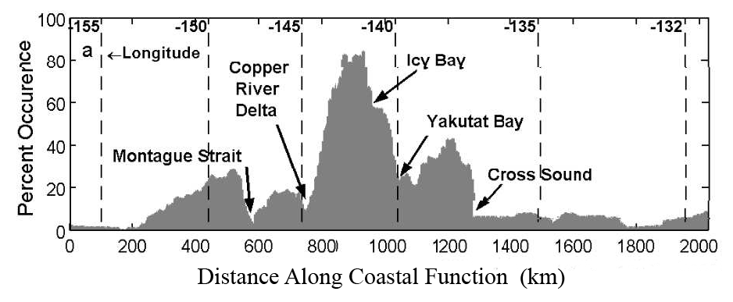
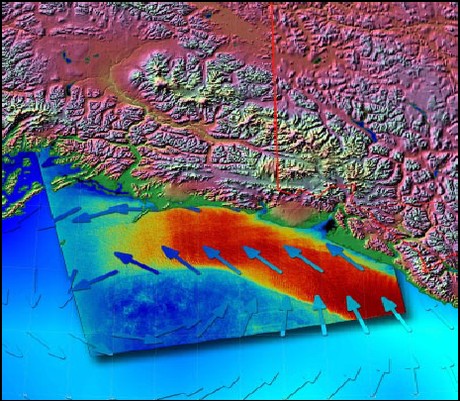
Coastal Wind Climatology
Barrier Jet Percent Occurrence along Northern
Coast of Gulf of Alaska – JHU/APL
(Winstead et al., 2006;
Monaldo et al., 2006, and Loescher et al, 2005)
Applications
  Met. Forecast Guidelines
  Wind Farm Location
  Ocean Engineering
  Coastal Decisionmaking
RADARSAT-1 Sept. 04, 2000 0306 GMT
Wind Image of Barrier Jet (Beal et al., 2005)

Slide 25
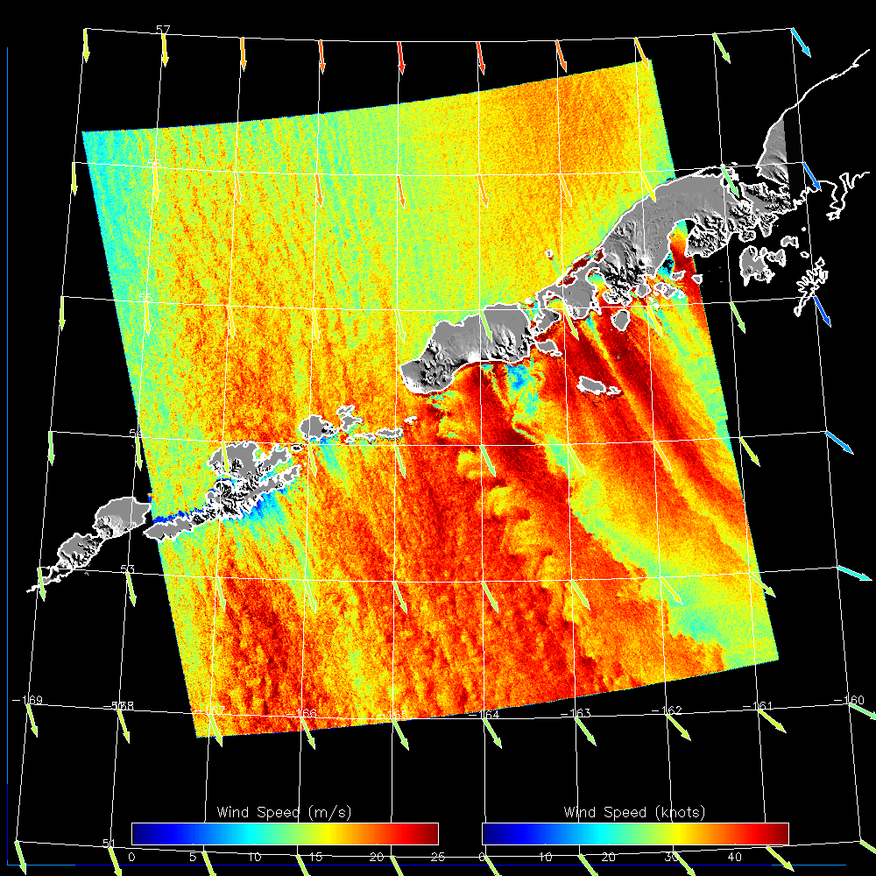
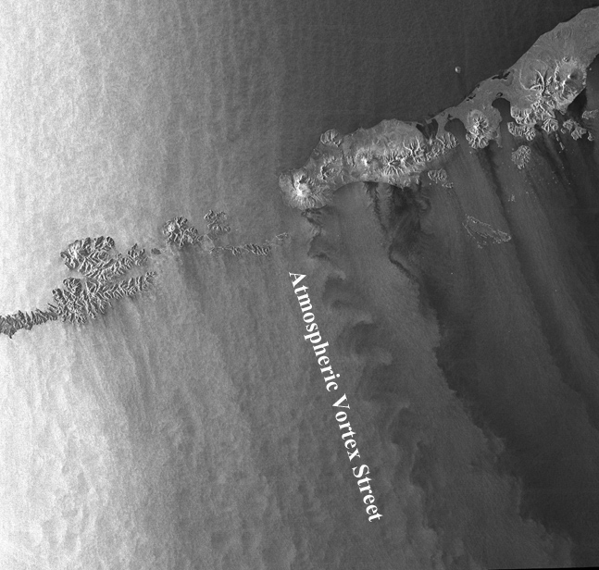
SAR-Observed Atmospheric Features
Atmospheric Vortex Streets
(c) CSA, 1999
RADARSAT synthetic aperture radar (SAR) image
RADARSAT synthetic aperture radar (SAR) image
22 Dec 1999 04:41 UTC
Alaska Peninsula

Slide 26
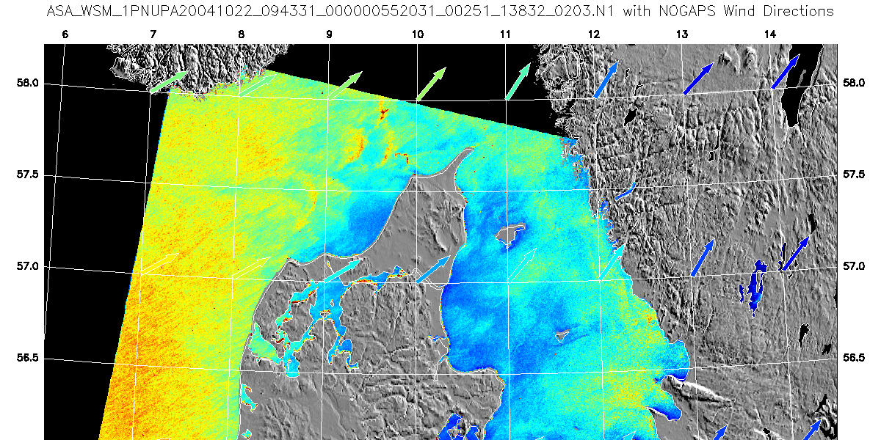
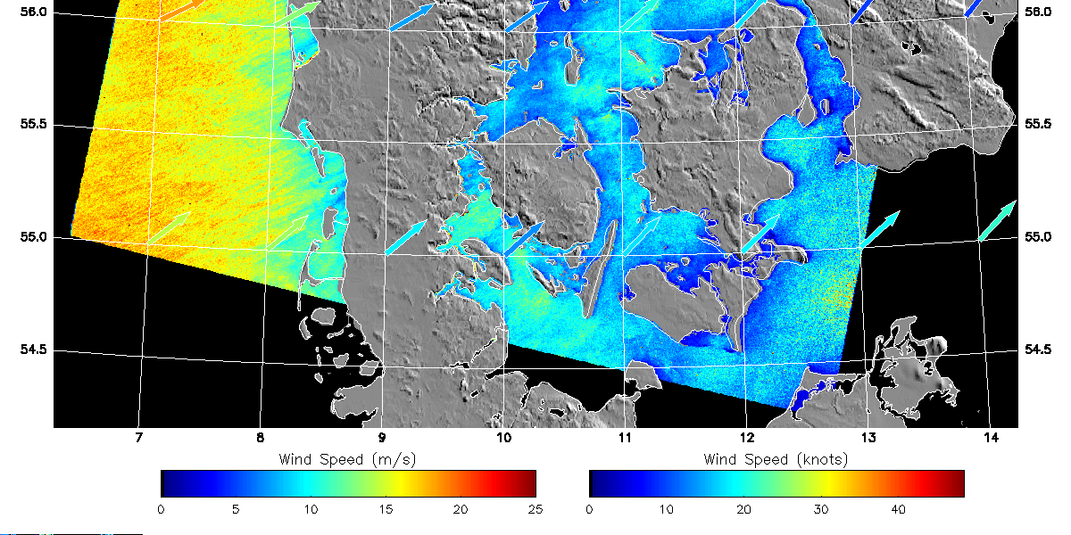
Horns Rev Wind Farm, Denmark
SAR Wind Image Derived from ENVISAT C-band SAR data
22 Oct 2004
Location of Horns Rev Wind Farm

Slide 27
Horns Rev Wind Farm
ALOS PALSAR Image
of Horns Rev Wind Farm,
Denmark
November 1, 2006
10:24:53 UT
Photograph of the 62 m tall meteorological mast M2 at Horns Rev
with the wind farm 2 km to the south.
Photo courtesy Paul B. Sørensen, Elsam Engineering A/S.

Slide 28
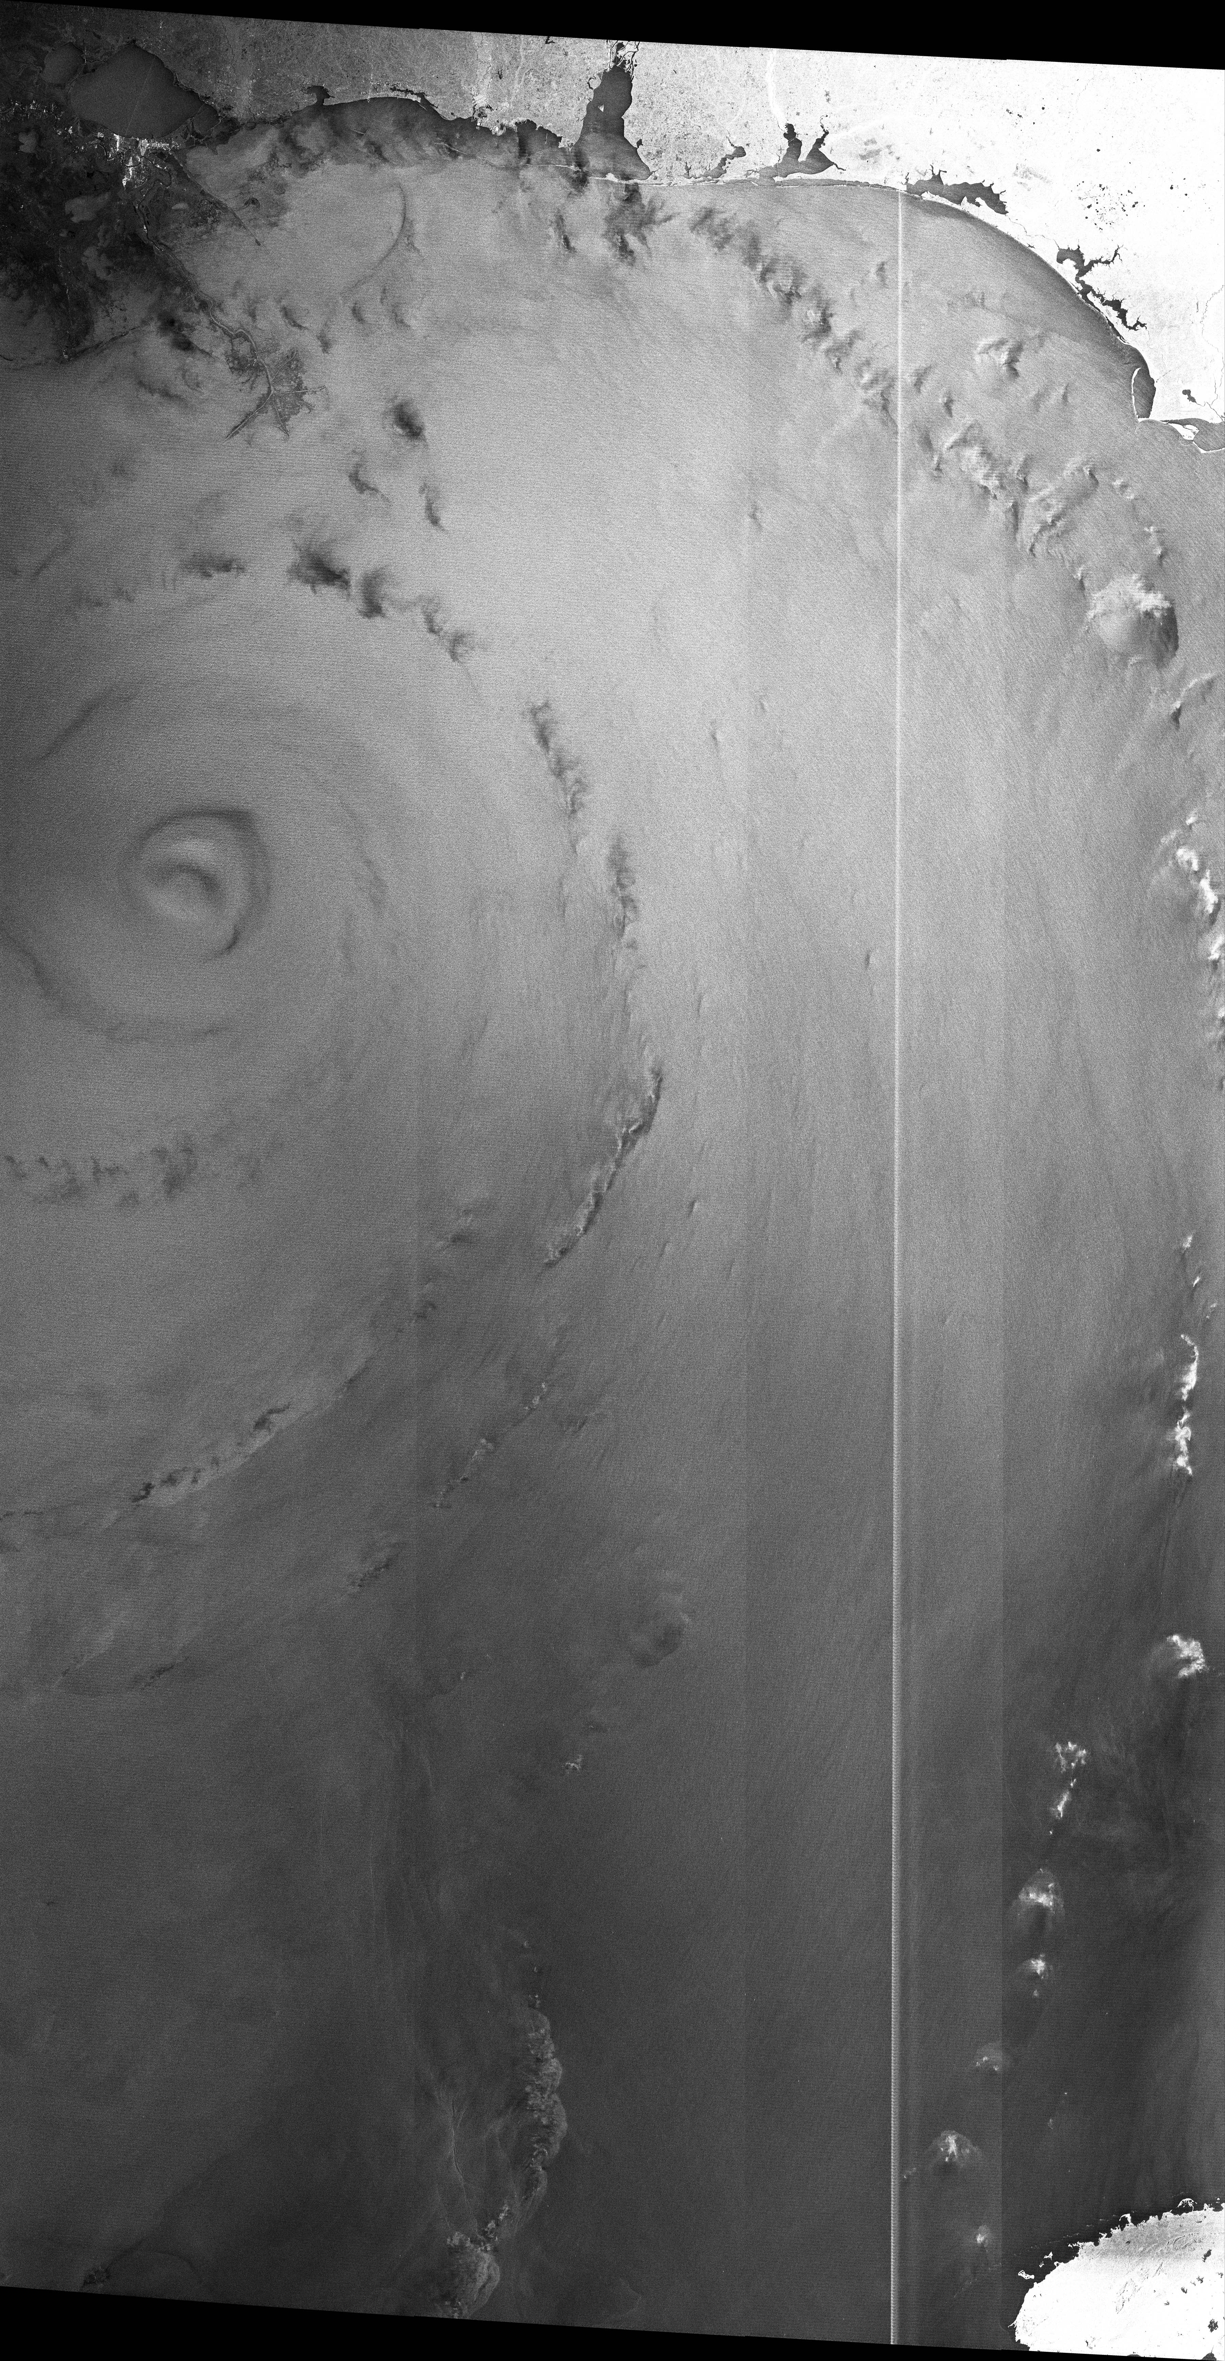
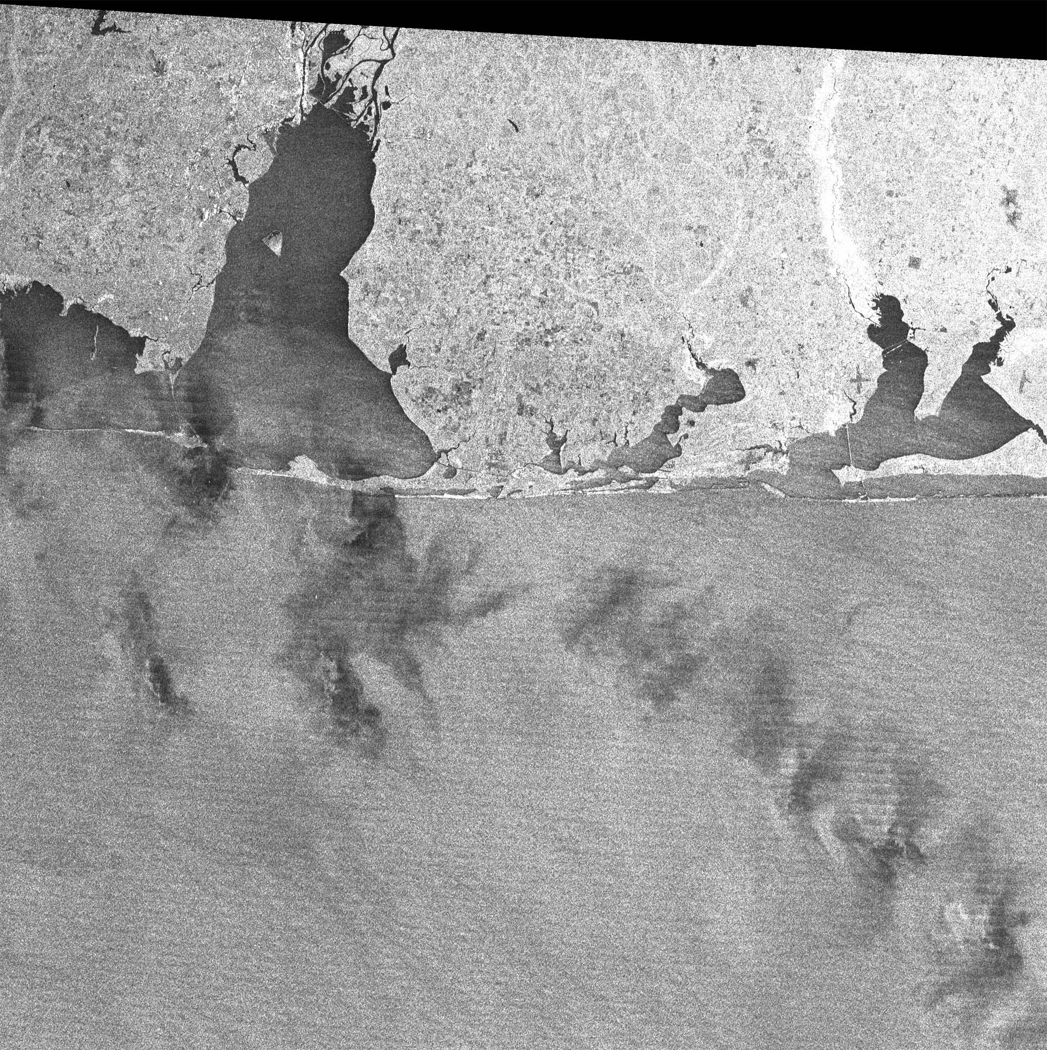
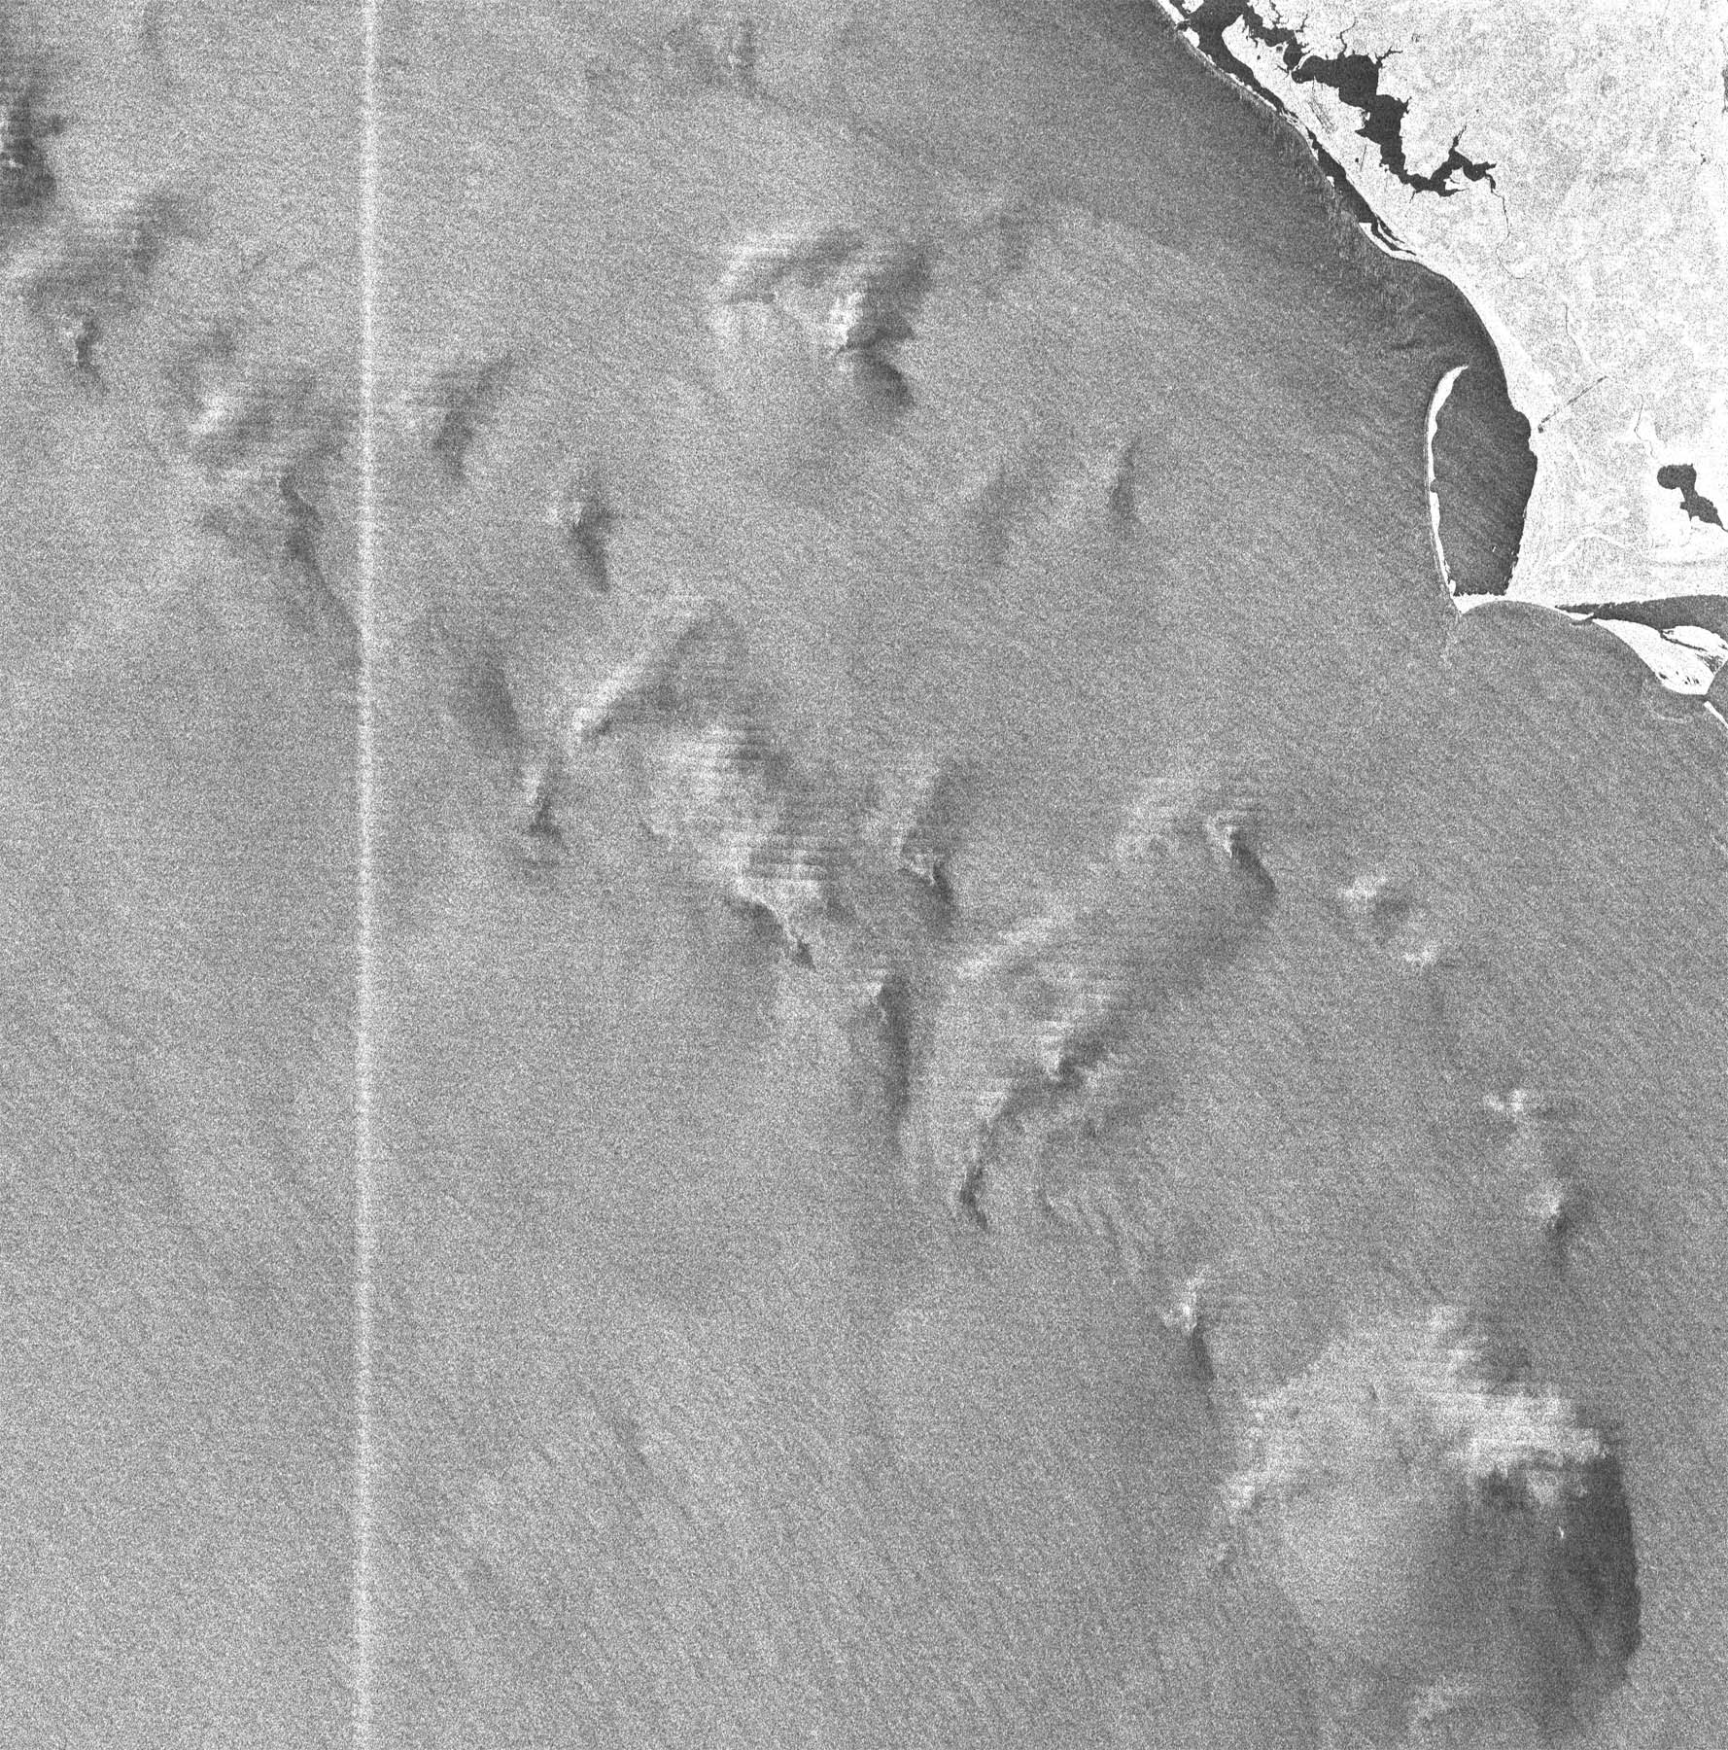
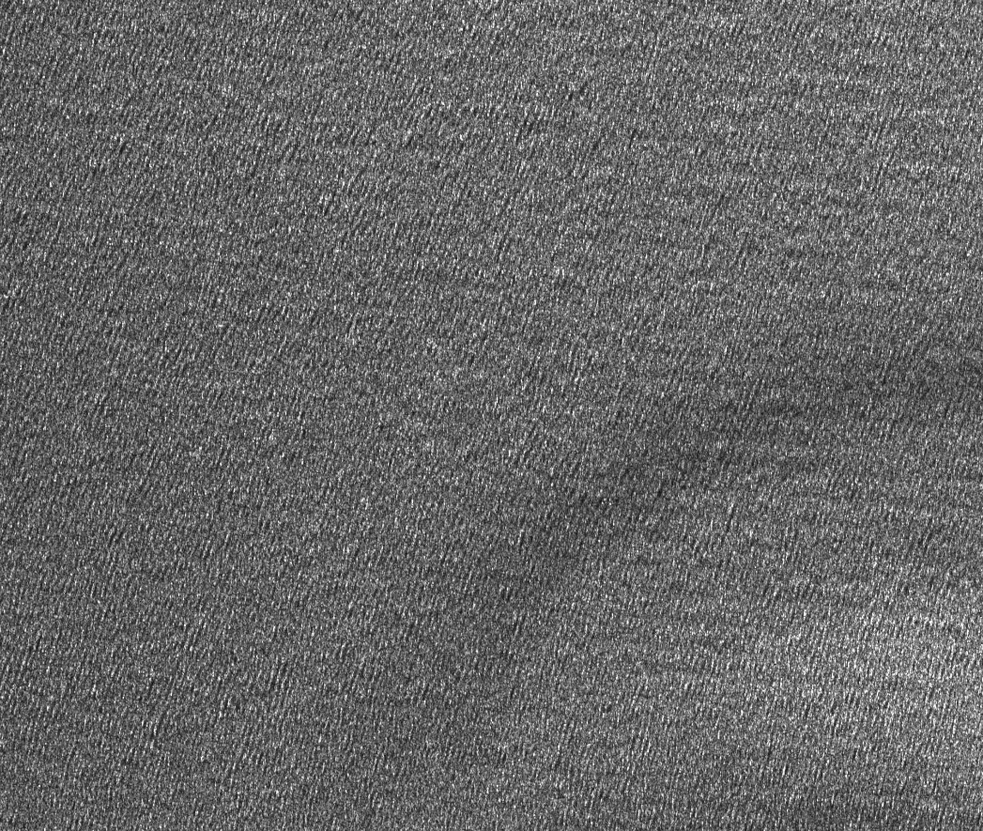
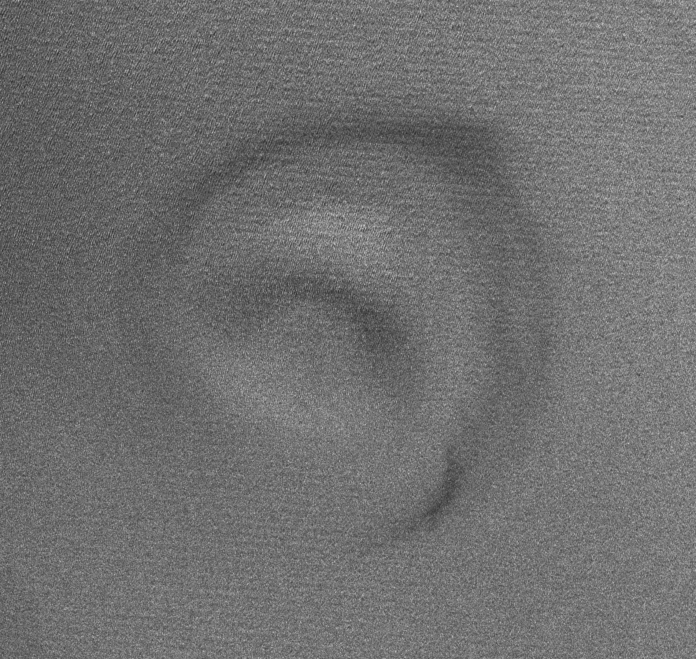
Hurricane Structure Information
Rain Band
Wind Rows
Convection Cell
Eye
Katrina 08/28/05
23:49 UT
RADARSAT-1 SAR
Swell Waves

Slide 29
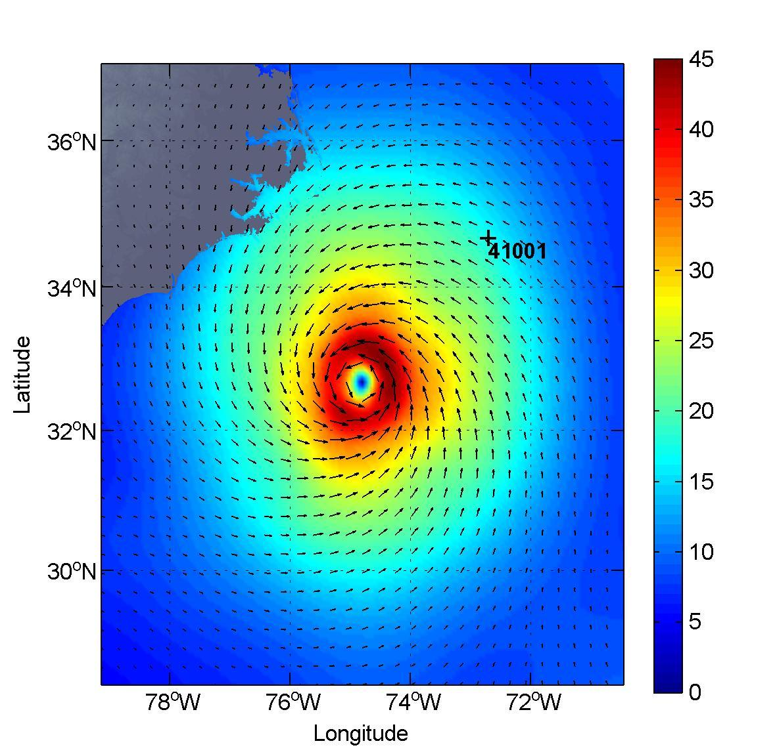
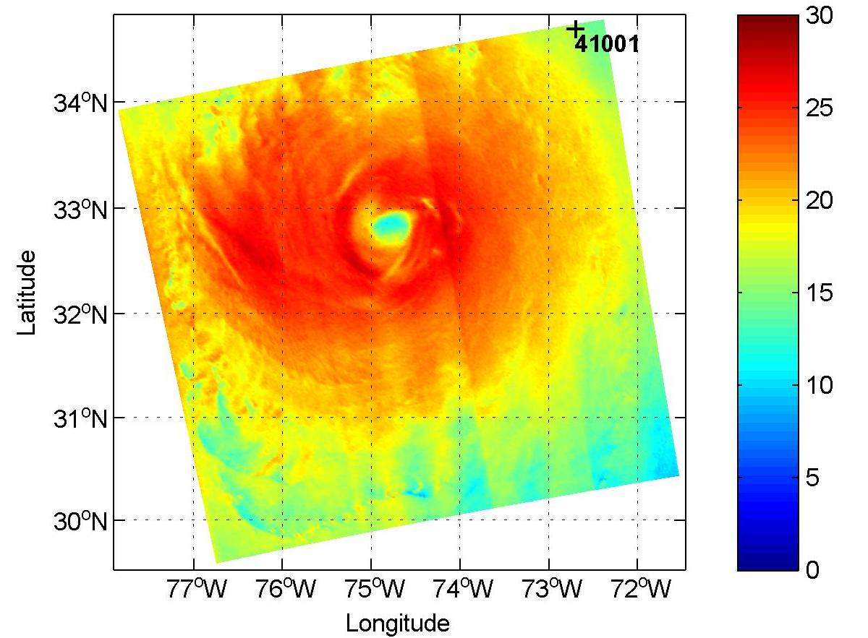
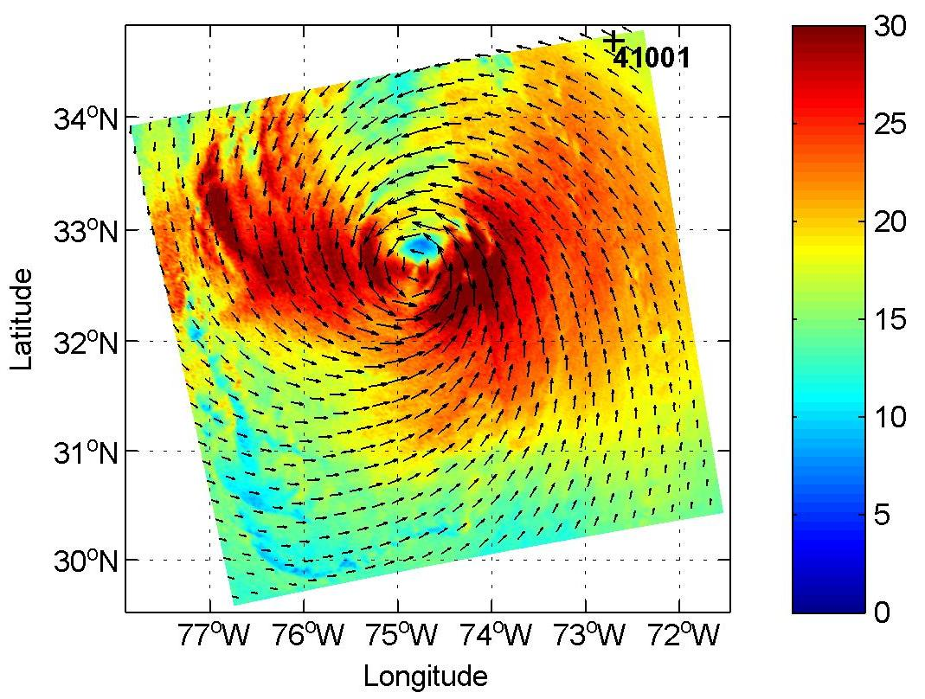
Improved SAR Hurricane Winds using
Cross-Polarization Data
Hurricane Earl on Sep 02, 2010 at 22:59 UTC
H*Winds (m/s)
Wind ~ COB model (m/s)
Wind ~ CMOD5.N (m/s)
COB – Cross-Polarization
Ocean Backscatter Model
(Will Perrie and Biao Zhang Bedford Institute of Oceanography Fisheries & Oceans Canada)
Wind speed from NDBC buoy #41001 is 18.1 m/s
from COB model is 16.0 m/s
from CMOD5.N is 17.4 m/s
from H*Wind is 16.8 m/s

Slide 30
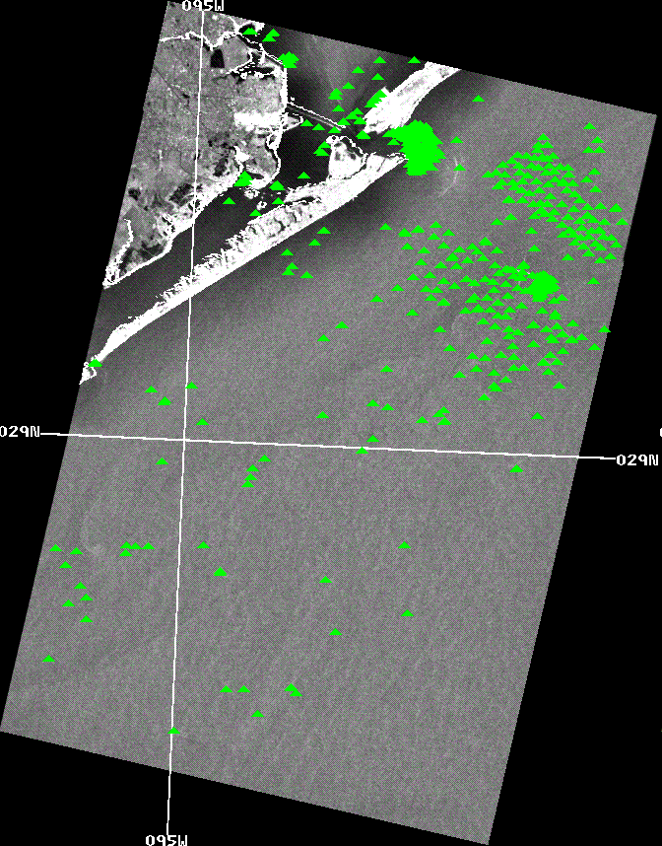
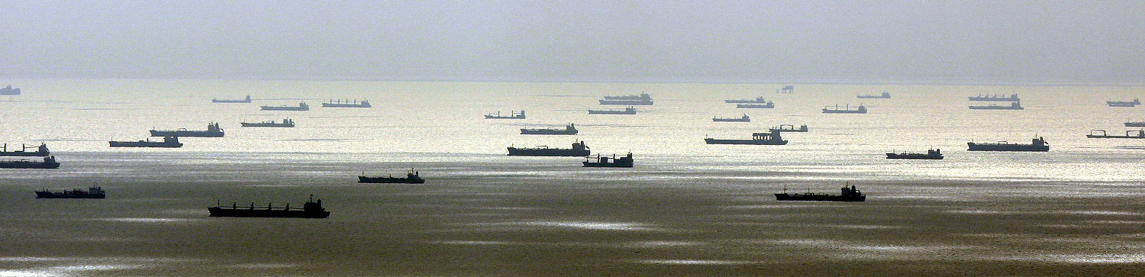
Ship and Oil Platform Detection
Parameter: Hard Targets – ships and oil platforms
Decision Support: Marine monitoring, oil platform changes, oil spill detection
Ship Detections
Envisat Standard Mode 17-Sept-2008
Ships waiting to enter Galveston after Hurricane Ike
(Ship Detections – General Dynamics- AIS and Global Ocean Associates)

Slide 31
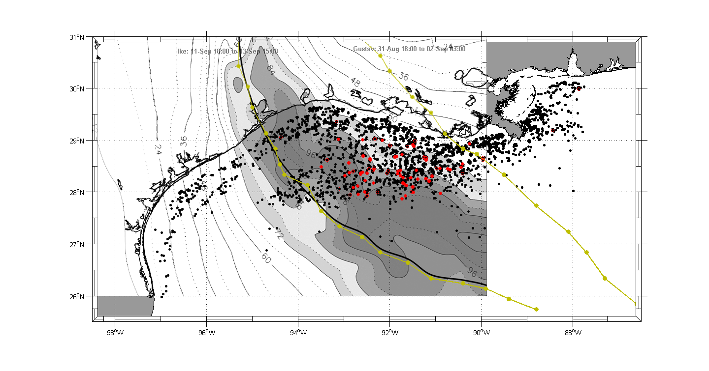
SAR Research - Oil Platform Change Detection after Hurricanes
Hurricane Ike - Post-Landfall Oil Platform Survey
MMS Assessed
Destroyed (60)
Damaged (31)

Slide 32
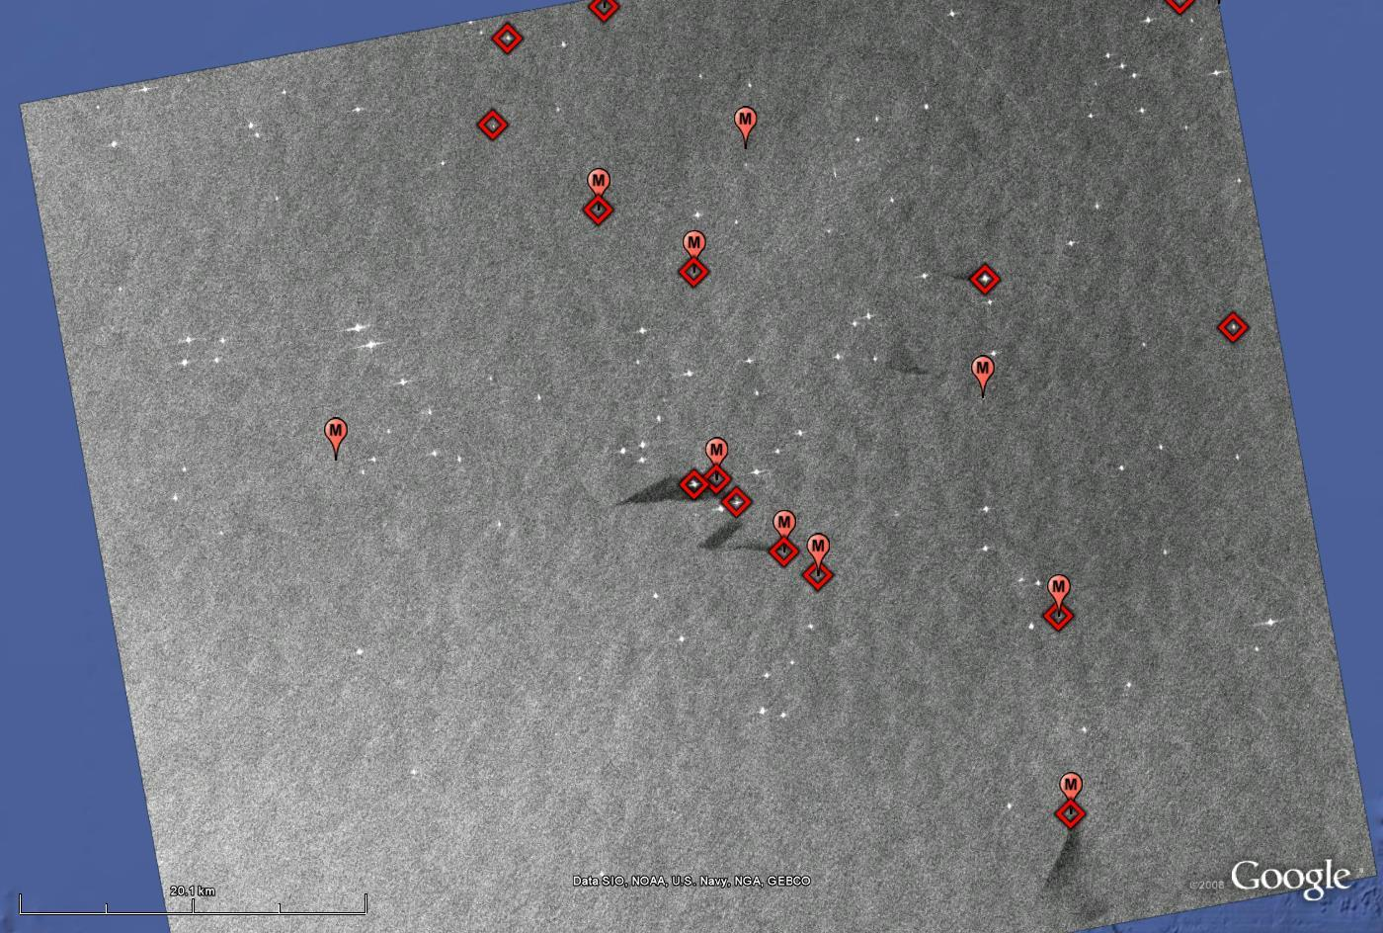
Oil Platform Change Detection
L-Band ALOS PALSAR Results after Hurricane Ike– 9/18/2008
SAR returns from “destroyed” platforms
Red - Destroyed
MMS positions with no SAR returns
Oil Spill
136 MMS platform positions covered by this image
8 of 16 Destroyed platforms designated as missing (M)
8 Destroyed platforms with SAR returns
Oil Spill
(Global Ocean Associates)
© JAXA, 2008

Slide 33
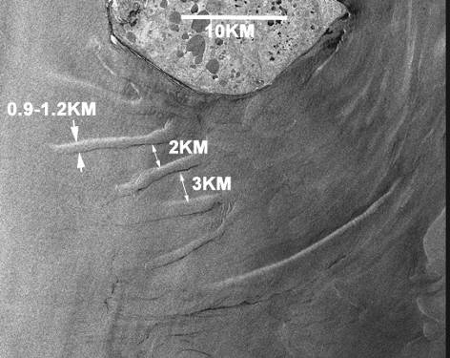
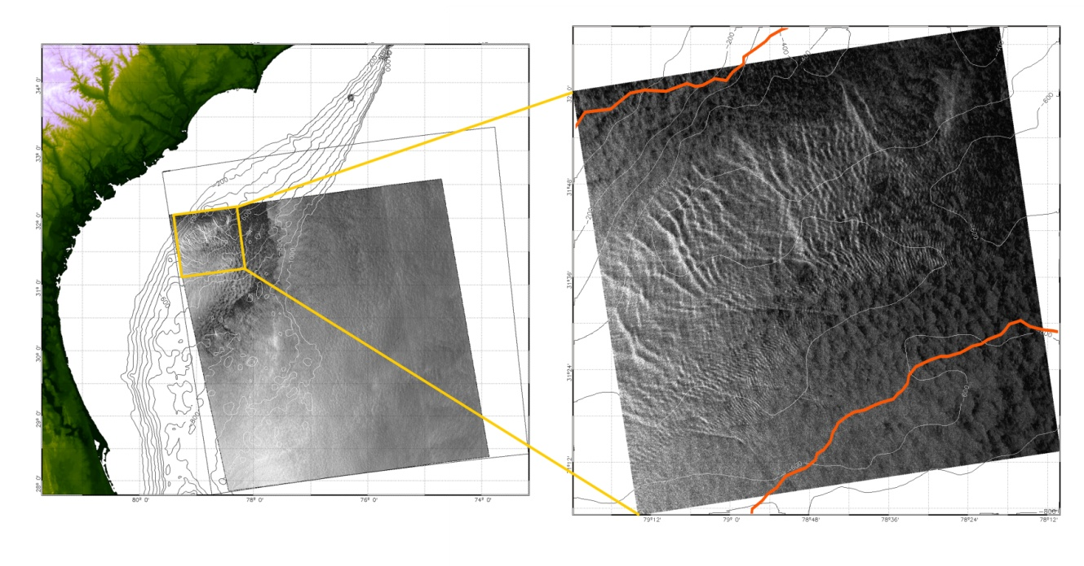
Current SAR Research – Bathymetric Features
Parameter: Shallow water bathymetric features
Decision Support: Support to mapping, change detection after storms
Shallow Water Bathymetric
Features in Bristol Bay
Alaska. RADARSAT-1
© CSA
RADARSAT-1 ScanSAR image shows the surface imprints of bathymetry features. Water depth is 450-500 m. SAR image is from 10/15/06 23:04 UT. Red lines are Gulf Stream boundary extracted from an AVHRR/SST. © CSA, 2006.
(Xiaofeng Li – IMSG at NOAA/NESDIS)
Bathymetric Features – Coastal Shallow Water, Gulf Stream Deep Water

Slide 34
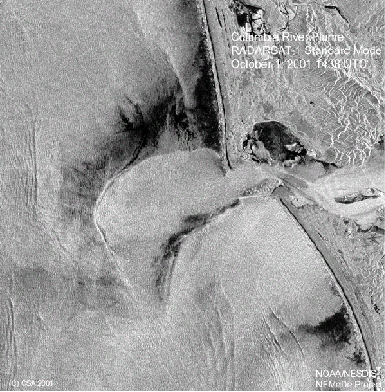
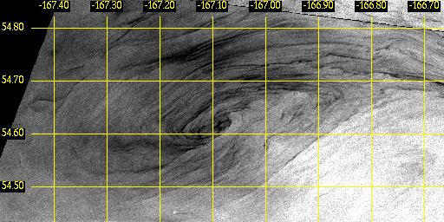
Ocean Feature Mapping with SAR
Parameter: River plumes, eddies, fronts, upwelling, internal waves
Decision Support: Fisheries, pollution monitoring
SAR Instruments image a wide variety of ocean surface phenomena, useful in marine monitoring.
Columbia River Plume
Eddy in Bering Sea

Slide 35
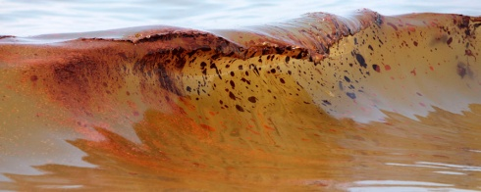
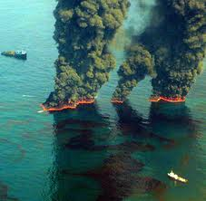
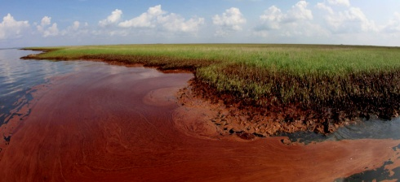
Deepwater Horizon Event –
Mapping of Surface Oil by NOAA Using Satellite Imagery
Oil washing ashore on Orange Beach, Ala.,
June 12, 2010. (AP Photo/Dave Martin)
Burning oil
(Oceanleadership.org)
Oil impacting wetland
in Barataria Bay,
Louisiana 6/8/10.
(AP Photo/
Charlie Riedel)

Slide 36
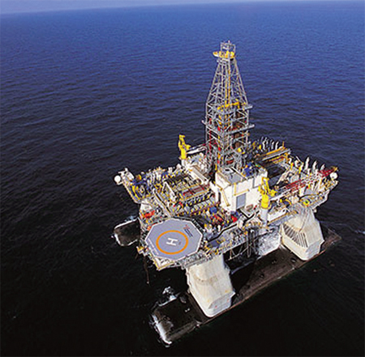
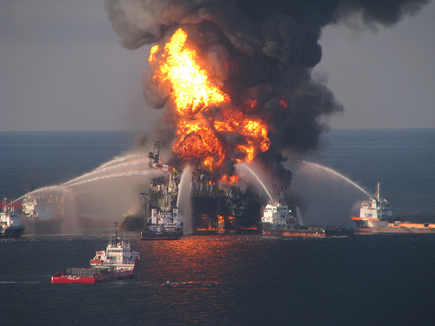

Deepwater Horizon Rig – Initial Accident
Background
Deepwater Horizon – a semi-submersible mobile offshore drilling unit
Located: 66 km southeast of the Mississippi Birdsfoot Delta – Macondo Prospect,
Block 252 of the Mississippi Canyon in 1500 m of water
Owner: Rig is owned by Transocean, BP is owner and principal developer of
Macondo Prospect
Accident
On April 20, 2010, methane gas from the well, erupted up and out of the drill pipe
and ignited, engulfing the platform. Most of the workers were evacuated, but 17 were
injured and 11 were never found despite a 3-day search. Efforts to put out the fire
were not successful, and the rig sank the morning of April 22, 2010. The drill pipe
collapsed and began leaking in three places.

Slide 37


NOAA Marine Pollution Surveillance Report and Shapefile
4/25/10 - TerraSAR-X SAR Image
NOAA/NESDIS/Satellite Analysis Branch began issuing Marine Pollution
Surveillance Reports on 4/22/10. Below is analysis for 4/25/10.

Slide 38


Reports Generated for Each Image
During the Deepwater Horizon Event, Experimental Marine Pollution Surveillance Reports were issued within a few hours of each image received -
around the clock, 7 days a week
Report with Image - RADARSAT-2 May 8, 2010
Report with Shapefile

Slide 39


Daily Composite Analyses Were Also Issued
Daily Composite Product – June 28, 2010

Slide 40



Both SAR and Visible Imagery Were Used
Both SAR and visible Sun glint imagery depict oil spill regions by specular reflection of radiation from the smooth ocean surface caused by oil damping of small waves.
TerraSAR-X
SAR Image
4/25/10
©infoterra,
2010
MODIS 250 m Visible Image 4/25/10 (NASA)

Slide 41






Multiple Passes per Day Aided Mapping the Entire
Extent of the Spill
Daily Composite Product 6/9/10
ALOS VV © JAXA, 2010
TERRA MODIS
RADARSAT-1 HH
ENVISAT VV
COSMO-SkyMed VV

Slide 42

SAR Coverage Frequency During
Deepwater Horizon
Red: International Disaster Charter
Blue: CSTARS University of Miami
258 Total Collections
21 April - 22 June 2010
21 April 2010

Slide 43



Development of Automated
Oil Spill Mapping Algorithm
May 2 ENVISAT ASAR VV Image
Left - Manual Analysis – Imagery - top
Shape File – bottom
STAR Research Automated Analysis –
Texture Classifying Neural Network Algorithm -
Florida State University Partnership - below

Slide 44

Frequent Analyses Allowed
Tracking of Oil Movement
Time sequence of oil spill maps derived from ENVISAT Advanced SAR (ASAR) imagery (May 31 and June 3) and RADARSAT-1 imagery (June 1). The Texture Classifying Neural Network Algorithm (TCNNA) was utilized to analyze the ASAR data.

Slide 45


Oil Spill Thickness Research – Deepwater Horizon
Florida State University and NOAA are
collaborating on a study of the use of
visible Sun glint imagery and SAR data to
obtain qualitative information on surface
oil thickness. Shipboard oil thickness
samples were taken during July for
algorithm development and validation.
Above: COSMO-SkyMed-2 SAR
image July 11, 2010 11:56Z.
Left: MODIS Visible image July 11,
2010 16:43Z. Oil outline from SAR
in blue; outline of possibly thicker
oil from MODIS in red.

Slide 46


Oceanographic Data was Employed to Understand Oil Motion
AOML Surface Current Analysis
Derived from Satellite Altimetry –
June 9, 2010
NESDIS Composite Analysis
June 8, 2010

Slide 47






Operational SAR Implementation in NOAA Status and Plans
There are currently 10 “commercial” SAR satellites in orbit
  Canada: Radarsat-1 (1995), Radarsat-2 (2008), C-Band
  ESA: ERS-2(1995), Envisat-ASAR(2002), C-Band
  Japan: ALOS-PALSAR (2006), L-band
  Italy: Cosmo-SkyMed (2007), X-band
    Currently 3 of 4 satellites on orbit
  Germany: TerraSAR-X (2007), Tandem-X , X-band
    Currently 2 satellites on orbit

Slide 48
Synthetic Aperture Radar (SAR) Satellite Missions
16
17
18
02
03
04
05
06
07
08
09
10
11
12
13
14
15
16
ESA: ERS-2
ESA: ENVISAT
Canada: RADARSAT-1
Canada: RADARSAT-2
Japan: ALOS/PALSAR
Germany: TerraSAR-X (2-Sats)
TerraSAR-X (2 satellites)
Italy: COSMO-SkyMed (4-Sats)
ESA: Sentinel-1 (2 Sats)
On orbit
Approved
Japan: ALOS 2
Planned/Pending
Canada: RCM (3 Sats)
US: DESDynI
Operational Data Sources
US: SMAP
Notes:
48

Slide 49
NOAA SAR-Derived Product Status
Sea/Lake Ice Products – Operational in NIC
River Ice Analyses – Routine in Alaska-Pacific River Forecast Center
Oil Spills – Experimentally operational in NESDIS/SAB – Operational
in 2011.
Coastal Winds – Operational implementation in NESDIS/OSDPD underway for July 2011 completion
Ship and platform positions – Experimental production in NESDIS/STAR
Oil platform change detection – Experimental in NESDIS/STAR

Slide 50
SAR Operational Implementation Plans
1. Continue the process of transitioning SAR applications such as
coastal winds, vessel positions, oil spill monitoring, and swell wave
measurements from research and experimental operations to full
operations using foreign SAR data.
2. NOAA and NIC will work with NASA and the Alaska Satellite Facility to
increase access to current SAR satellites such as ALOS-1 and ENVISAT.
3. Work with Environment Canada to develop MOUs for joint
operational production of SAR winds and oil spills similar to agreements
in place for ice products.
4. Vigorously pursue full access to future foreign operational
SAR missions, particularly RCM and Sentinel-1, but also ALOS-2, and
perhaps others.
5. Work with NASA to obtain operational access to research SAR missions
(i.e., DESDynI and SMAP).

Slide 51


Information on NOAA SAR Applications
Two SAR User’s Guides available
on line.
http://www.star.nesdis.noaa.gov/sod/mecb/sar/publications.htm

Slide 52

Deepwater Horizon Event Time Series
NESDIS SAB Experimental Marine Pollution Surveillance Daily Composite Product
Derived From SAR and High-Resolution Visible Imagery

